Slide 1
Point to ponder in copy constructor
We need to define our own copy constructor only if an object has pointers or any runtime allocation of the resource like filehandle, a network connection..etc. The default constructor does only shallow copy.
Deep copy is possible only with user defined copy constructor. In user defined copy constructor, we make sure that pointers (or references) of copied object point to new memory locations.

Slide 2
class String { private: char *s; int size; public: void print() { cout << s << endl; } String(const char *str) { size = strlen(str); s = new char[size+1]; strcpy(s, str); } void change(const char *str) { delete [] s; size = strlen(str); s = new char[size+1]; strcpy(s, str); } ~String() { delete [] s; }
String(const String& old_str)
{
size = old_str.size;
s = new char[size+1];
strcpy(s, old_str.s);
}
};
int main()
{
String str1("Quiz");
String str2 = str1;
str1.print(); // what is printed ?
str2.print();
str2.change(“QQQuiz");
str1.print(); // what is printed now ?
str2.print();
return 0;

Slide 3
C++ Operator Overloading
In C++, we can change the way operators work for user-defined types like objects and structures. This is known as operator overloading.
Perform operations on class objects as performed on system defined datatypes.
For Example:
cout << myobj;
myobj == otherobj;
myobj++;
myobj = otherobj +3;

Slide 4
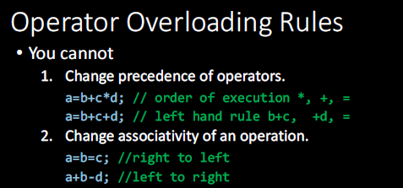

Slide 5
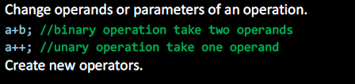

Slide 6
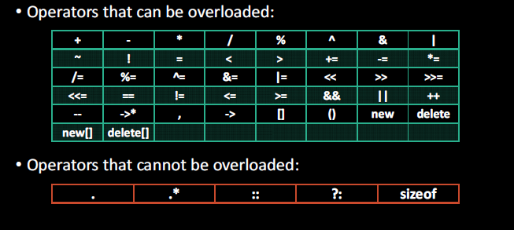
Operators that can be overloaded

Slide 7
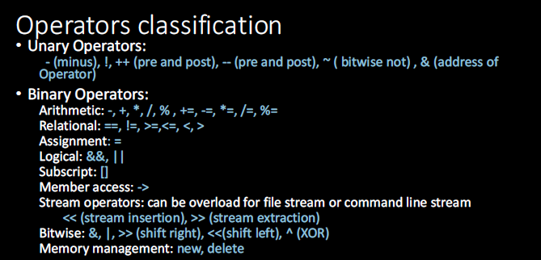

Slide 8
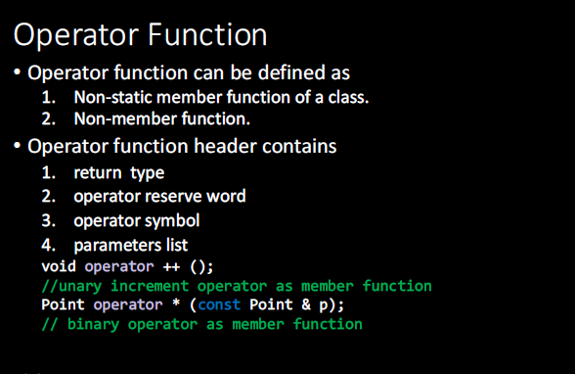

Slide 9
Overloading Unary Operators
class Counter
{
private:
unsigned int count; //count
public:
Counter() : count(0) //constructor
{ }
unsigned int get_count() //return count
{ return count; }
void operator ++ () //increment (prefix)
{
++count;
}
};
int main()
{
Counter c1, c2; //define and initialize
cout << c1.get_count();
cout << c2.get_count();
++c1;
++c2;
++c2;
cout << c1.get_count(); cout <<c2.get_count() << endl;
}

Slide 10
Overloading Unary Operators
The operator Keyword
The keyword operator is used to overload the ++ operator in this declarator:
void operator ++ ().
The return type (void in this case) comes first, followed by the keyword operator, followed by the operator itself (++), and finally the argument list enclosed in parentheses (which are empty here). This declarator syntax tells the compiler to call this member function whenever the ++ operator is encountered, provided the operand
Notes:
that the only way the compiler can distinguish between
overloaded functions is by looking at the data types and the number of their arguments

Slide 11
Operator Return Values
class Counter
{
private:
unsigned int count; //count
public:
Counter() : count(0) //constructor
{ }
unsigned int get_count() //return count
{ return count; }
Counter operator ++ () //increment count
{
++count;
Counter temp;
temp.count = count;
return temp;
}};
int main()
{
Counter c1, c2; //define and initialize
cout << c1.get_count();
cout << c2.get_count();
++c1; //c1=1
c2 = ++c1;
cout << c1.get_count(); cout <<c2.get_count() << endl;
}

Slide 12
Nameless Temporary Objects
class Counter
{
private:
unsigned int count; //count
public:
Counter() : count(0) //constructor
{ }
unsigned int get_count() //return count
{ return count; }
Counter operator ++ () //increment count
{
++count;
return Counter(count);
}
};
int main()
{
Counter c1, c2; //define and initialize
cout << c1.get_count();
cout << c2.get_count();
++c1; //c1=1
c2 = ++c1;
cout << c1.get_count(); cout <<c2.get_count() << endl;
}

Slide 13
Postfix Notation
c1=0
c2=0
c1=2
c2=2
c1=3
c2=2
To make both versions of the increment operator work, we define two overloaded ++ operators,
class Counter
{
private:
unsigned int count; //count
public:
Counter() : count(0) //constructor
{ }
unsigned int get_count() //return count
{ return count; }
Counter operator ++ () //increment count
{
++count;
return Counter(count);
}
Counter operator ++ (int) {
return Counter(count++);
}
};
int main()
{
Counter c1, c2; //define and initialize
cout << c1.get_count();
cout << c2.get_count();
++c1; //c1=1
c2 = ++c1;
cout << c1.get_count(); cout <<c2.get_count() << endl;
c2 = c1++;
cout << c1.get_count(); cout <<c2.get_count() << endl;
}

Slide 14
Postfix Notation
The only difference is the int in the parentheses. This int isn’t really an argument, and it
doesn’t mean integer. It’s simply a signal to the compiler to create the postfix version of the operator.

Slide 15
Overloading Binary Operators
dist3.add_dist(dist1, dist2); By overloading the + operator we can reduce this dense-looking expression to
dist3 = dist1 + dist2;
Distance operator + ( Distance d2) const{
int f = feet + d2.feet;
float i = inches + d2.inches;
if(i >= 12.0)
{i -= 12.0; f++;}
return Distance(f,i);
}
D3=d1.add(d2)

Slide 16
Overloading Binary Operators
Distance operator + ( Distance d2) {
int f = feet + d2.feet;
float i = inches + d2.inches;
if(i >= 12.0)
{i -= 12.0; f++;}
return Distance(f,i);
}
int main()
{
Distance dist1, dist3, dist4;
dist1.getdist();
Distance dist2(11, 6.25);
dist3 = dist1 + dist2;
dist4 = dist1 + dist2 + dist3;
//display all lengths
cout << “dist1 = “; dist1.showdist(); cout << endl;
cout << “dist2 = “; dist2.showdist(); cout << endl;
cout << “dist3 = “; dist3.showdist(); cout << endl;
cout << “dist4 = “; dist4.showdist(); cout << endl;
}

Slide 17
Overloading Binary Operators

Slide 18
Using this for Returning Values
When you call a member function, it comes into existence with the value of this set to the
address of the object for which it was called. The this pointer can be treated like any other
pointer to an object, and can thus be used to access the data in the object it points to,
class alpha
{
private:
int data;
public:
alpha() //no-arg constructor
{ }
alpha(int d) //one-arg constructor
{ data = d; }
void display() //display data
{ cout << data; }
alpha operator = (alpha a) //overloaded = operator
{
cout <<this;
data = a.data; //not done automatically
return *this; //return copy of this alpha
}
};
int main()
{
alpha a1(37);
alpha a2, a3;
Cout<<&a1<<“ “<<&a2<<“ ”<<&a3;
a3 = a2 = a1; //invoke overloaded =, twice
a2.display(); //display a2
a3.display(); //display a3
cout << endl;
return 0;
}

Slide 19
Since this is a pointer to the object of which the function is a member, *this is that object itself, and the statement returns it by reference.
a2=37
a3=37
Each time the equal sign is encountered in
a3 = a2 = a1;
the overloaded operator=() function is called, which prints the messages. The three objects all end up with the same value.
You usually want to return by reference from overloaded assignment operators, using *this, to avoid the creation of extra objects.

Slide 20
Task
The example shown here is a complete program that shows one way to create your own array
class:
#include <iostream>
using namespace std;
////////////////////////////////////////////////////////////////
class Array {
private:
int* ptr; //pointer to Array contents
int size; //size of Array
public:
Array(int s)
{
size = s;
ptr = new int[s];
}
~Array() { delete[] ptr; }
Int& operator [] (int j)
{ return ptr[j]; }
};
////////////////////////////////////////////////////////////////
int main()
{
const int ASIZE = 10; //size of array
Array arr(ASIZE); //make an array
for(int j=0; j<ASIZE; j++) //fill it with squares
arr[j] = j*j;
for(j=0; j<ASIZE; j++) //display its contents
cout << arr[j] << ‘ ‘;
cout << endl;
}

Slide 21
Binary Operator == is equal to
Point p1(3, 4), p2(3, 2);
p1.operator==(p2); // called on p1
Or
cout << (p1==p2);
class Point {
int x, y;
public:
Point(int a=0, int b=0) { x=a; y=b;}
bool operator==(const Point&);
};
//implementation
bool Point:: operator==(const Point& p){
if (x == p.x && y == p.y)
return true;
else
return false;

Slide 22
Binary Operator != not equal to
class Point {
int x, y;
public:
Point(int a=0, int b=0) { x=a; y=b;}
bool operator==(const Point&);
bool operator!=(const Point&);
};
//Reuse == operator function
bool Point:: operator!=(const Point& p){
15
return !((*this) == p) ;
}
Point p1(3, 4), p2(3, 2);
p1.operator!=(p2); // called on p1
Or
cout << (p1!=p2);

Slide 23
Binary Operator != not equal to
p1=p2; // called on p1
p1=p2=p3; // cascaded call

Slide 24
Binary Operator = Assignment
Point Point::operator=(const Point& p){
if (this != &p) {
x= p.x;
if(y==nullptr && p.y!=nullptr)
y = new int(*(p.y));
else if(y!=nullptr && p.y==nullptr){
delete y;
y = nullptr;
}
else if(y!=nullptr && p.y!=nullptr)
*y = *(p.y);
}
return *this;
}
class Point {
int x, *y;
public:
Point() { x=0; y=nullptr; }
Point(int a, int b) {
x=a;
y=new int(b);
}
Point operator=(const Point& p);
};

Slide 25
Friend function
A friend function in C++ is defined as a function that can access private, protected and public members of a class.
The friend function is declared using the friend keyword inside the body of the class.
Friend Function Syntax:
class className {
... .. ...
friend returnType functionName(arguments);
... .. ...
}
By using the keyword, the ‘friend’ compiler understands that the given function is a friend function.

Slide 26
Breaching the Walls
We should note that friend functions are controversial. During the development of C++, arguments raged over the desirability of including this feature. On the one hand, it adds flexibility to the language; on the other, it is not in keeping with data hiding, the philosophy that only member functions can access a class’s private data.
How serious is the breach of data integrity when friend functions are used? A friend function must be declared as such within the class whose data it will access. Thus a programmer who does not have access to the source code for the class cannot make a function into a friend. In this respect, the integrity of the class is still protected

Slide 27
Use of Friend function in C++
As discussed, we require friend functions whenever we have to access the private or protected members of a class. This is only the case when we do not want to use the objects of that class to access these private or protected members.
To understand this better, let us consider two classes: Tokyo and Rio. We might require a function, metro(), to access both these classes without any restrictions. Without the friend function, we will require the object of these classes to access all the members.

Slide 28
class Distance //English Distance class
{
private:
int feet;
float inches;
public:
Distance() : feet(0), inches(0.0) { }
Distance(float fltfeet) {
feet = fltfeet;
inches = 12*(fltfeet-feet);}
Distance(int ft, float in) { feet = ft; inches = in; }
void showdist()
{ cout << feet << “\’-” << inches << ‘\”’; }
Distance operator + (Distance d2)
{
int f = feet + d2.feet;
float i = inches + d2.inches;
if(i >= 12.0) //if total exceeds 12.0,
{ i -= 12.0; f++; }
return Distance(f,i);
}
int main()
{
Distance d1 = 2.5; //constructor converts
Distance d2 = 1.25; //float feet to Distance
Distance d3;
cout << “\nd1 = “; d1.showdist();
cout << “\nd2 = “; d2.showdist();
d3 = d1 + 10.0;
cout << “\nd3 = “; d3.showdist();
// d3 = 10.0 + d1; //float + Distance: ERROR
// cout << “\nd3 = “; d3.showdist();
cout << endl;
return 0;
}
d3 = Distance(10, 0) + d1; this will work but this is not good so As you may have guessed, a friend can help you out of this dilemma.

Slide 29
class Distance //English Distance class
{
private:
int feet;
float inches;
public:
Distance() : feet(0), inches(0.0) { }
Distance(float fltfeet) {
feet = static_cast<int>(fltfeet);
inches = 12*(fltfeet-feet);}
Distance(int ft, float in) { feet = ft; inches = in; }
void showdist()
{ cout << feet << “\’-” << inches << ‘\”’; }
friend Distance operator + (Distance, Distance)
};
int main()
{
Distance d1 = 2.5; //constructor converts
Distance d2 = 1.25; //float-feet to Distance
Distance d3;
cout << “\nd1 = “; d1.showdist();
cout << “\nd2 = “; d2.showdist();
d3 = d1 + 10.0; //distance + float: OK
cout << “\nd3 = “; d3.showdist();
d3 = 10.0 + d1; //float + Distance: OK
cout << “\nd3 = “; d3.showdist();
cout << endl;
return 0;
}
Distance operator + (Distance d1, Distance d2) {
int f = d1.feet + d2.feet;
float i = d1.inches + d2.inches;
if(i >= 12.0) //if inches exceeds 12.0,
{ i -= 12.0; f++; }
return Distance(f,i);
}

Slide 30
friend Classes
#include <iostream>
using namespace std;
class alpha
{
private:
int data1;
public:
alpha() : data1(99) { } //constructor
friend class beta; //beta is a friend class
};
class beta
{ //all member functions can
public: //access private alpha data
void func1(alpha a) { cout << “\ndata1=” << a.data1; }
void func2(alpha a) { cout << “\ndata1=” << a.data1; }
};
////////////////////////////////////////////////////////////////
int main()
{
alpha a;
beta b;
b.func1(a);
b.func2(a);
cout << endl;
return 0;
}
In class alpha the entire class beta is proclaimed a friend. Now all the member functions of
beta can access the private data of alpha

Slide 31
Overload a binary operator using non member function
class Complex
{
private:
float real;
float imag;
public:
Complex(){}
Complex(float r, float i)
{
real = r;
imag = i;
}
void display()
{
cout<<real<<"+i"<<imag;
}
friend Complex operator +(Complex &, Complex &);
};
Complex operator +(Complex &c1, Complex &c2)
{
Complex temp;
temp.real = c1.real + c2.real;
temp.imag = c1.imag + c2.imag;
return temp;
}
int main()
{
Complex c1(3, 4);
Complex c2(4, 6);
Complex c3 = c1+c2;
c3.display();
return 0;
}
Notes:
For non member operator overloading, you have to use friend function

Slide 32
function is friendly for two classes.
#include<iostream>
using namespace std;
class B; //forward declaration.
class A
{
int x;
public:
void setdata (int i)
{
x=i;
}
friend void max (A, B); //friend function.
} ;
void max (A a, B b)
{
if (a.x >= b.y)
std:: cout<< a.x << std::endl;
else
std::cout<< b.y << std::endl;
}
int main ()
{
A a;
B b;
a. setdata (10);
b. setdata (20);
max (a, b);
return 0;
}
class B
{
int y;
public:
void setdata (int i)
{
y=i;
}
friend void max (A, B);
};

Slide 33
We must know the following things before we start overloading these operators. 1) cout is an object of ostream class and cin is an object of istream class 2) These operators must be overloaded as a global function. And if we want to allow them to access private data members of the class, we must make them friend. Why these operators must be overloaded as global? In operator overloading, if an operator is overloaded as a member, then it must be a member of the object on the left side of the operator. For example, consider the statement “ob1 + ob2” (let ob1 and ob2 be objects of two different classes). To make this statement compile, we must overload ‘+’ in a class of ‘ob1’ or make ‘+’ a global function. The operators ‘<<‘ and ‘>>’ are called like ‘cout << ob1’ and ‘cin >> ob1’. So if we want to make them a member method, then they must be made members of ostream and istream classes, which is not a good option most of the time. Therefore, these operators are overloaded as global functions with two parameters, cout and object of user-defined class.
Notes:
Rectangle operator++()
{
Rectangle r(*this);
r.l = ++l;
r.w = ++w;
return r;
}
Rectangle operator++(int)
{
Rectangle r(*this);
r.l = l++;
r.w = w++;
return r;
}
};
int main()
{
Rectangle r1(10.0, 20.0), r2(2.0, 5.0);
Rectangle r3 = r1+r2;
r3.print();
Rectangle r4 = -r3;
r4.print();
cout<<r1++<<endl;
cout<<++r2 <<endl;
cout<<endl<<endl;
return 0;
}

